Slide 1



Logo placeholder
ENTER PEP NAME Pooled Employer Plan
A Simple Comprehensive 401(k) Solution

Slide 2
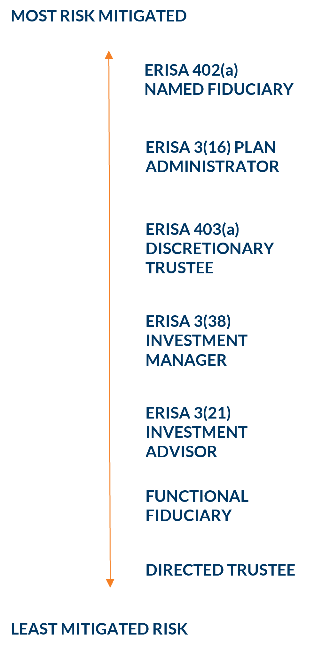



What is a Pooled Employer Plan (PEP)?
A simple, comprehensive 401(k) solution that minimizes your time and risk spent managing 401(k) plans and gets you back to doing what you love: growing your business.
Save Time
By handing off most of the responsibilities of governing and administering your retirement plan to a prudent expert, you can focus more of your time on your business. Would you rather be distributing plan notices and dealing with plan auditors or serving your clients and employees?
Reduce Risk
We’ve assembled world-class partners who will provide safeguards to reduce your fiduciary liability (risk). The PEP removes as much of the fiduciary liability of operating a retirement plan as is allowed by law away from the adopting employer. Reflected on the right, ordered by their level of potential fiduciary risk, is a representation of the various plan fiduciary roles as they are defined under ERISA.
Potentially Reduce Costs
You’ll experience price breaks that were previously only available to much larger companies. If your plan is audited today or will soon require an audit, you can substantially reduce or eliminate your audit fee by joining a PEP.

Slide 3

What’s Included?
PEP
Traditional 401(k)
Comprehensive Retirement Plan Governance | ✓ | ×
Remove Responsibility to Sign and File 5500 | ✓ | ×
Significantly Reduce Fiduciary Liability | ✓ | ×
Eliminate Plan Document Maintenance | ✓ | ×
Customized Plan Design | ✓ | ✓
Considerably Reduce Employer Responsibilities | ✓ | ×
Loan/Distribution/QDRO Approval & Processing | ✓ | ×
Remove Liability for Fraudulent Transactions | ✓ | ×
Annual Compliance Assessment and Fee Benchmarking | ✓ | ×
Eliminate Individual Plan Audit (if applicable) | ✓ | ×
Payroll Integration | ✓ | ✓

Slide 4
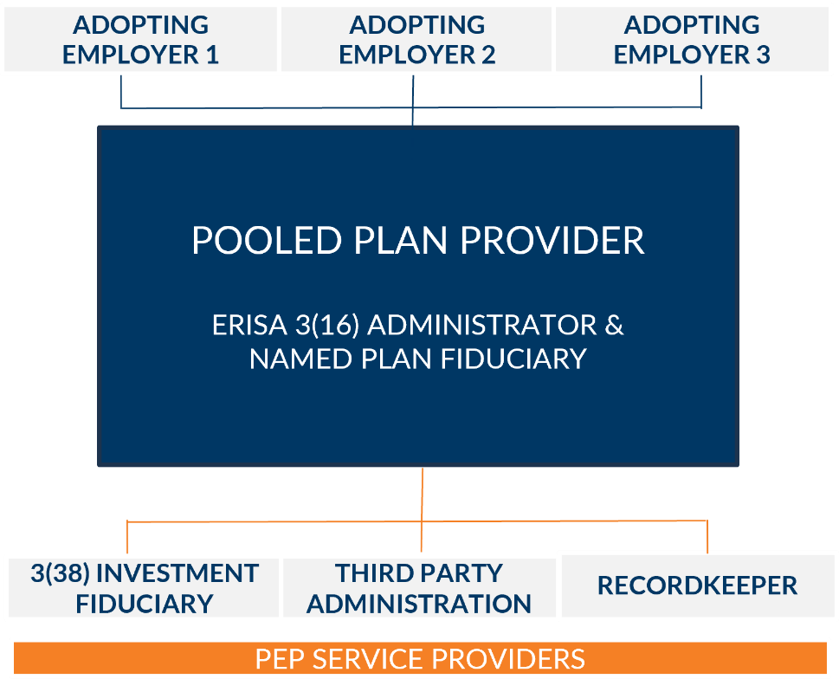
Your Team
World-Class Partnership
Structure
We’ve designed a simplified retirement solution that allows multiple employers to “pool” their resources together into one retirement plan to have access to benefits historically only available to larger companies.
ERISA SECTION 3(38) INVESTMENT FIDUCIARY | Provided by: | Selection and monitoring of plan investments Responsible investment fiduciary
POOLED PLAN PROVIDER & 3(16) FIDUCIARY | Provided by: | Registers as a Pooled Plan Provider Responsible for all administrative duties of the plan Approves all participant loans & distributions
THIRD PARTY ADMINISTRATOR (TPA) | Provided by: | Plan design Annual compliance testing Preparation of all required government filings
RECORDKEEPER | Provided by: | Daily transaction processing Sponsor and participant website hosting Quarterly participant statements

Slide 5

An Institutional Fiduciary
You Can Count On
100+
Pooled Plan Provider for more than 100 PEPs
100+
About Us
FiduciaryxChange
With more than 40 years of industry experience, Jeff Atwell leads FiduciaryxChange, the outsourced fiduciary services offering of AmericanTCS Fiduciary Services. Since 2007, FiduciaryxChange has been a trusted provider of fiduciary solutions and has grown to become one of the largest Pooled Plan Providers (PPPs) in the United States, supporting more than 100 Pooled Employer Plans (PEPs), 1,200 companies and 70,000 participants. The team also serves as a 402(a) Named Fiduciary and 3(16) Fiduciary for a broad range of single-employer retirement plans, helping clients meet their fiduciary obligations under the Prudent Expert Standard of Care.
$3B+
More than $3 billion in PEP plan assets
70k+
More than 70,000 participants in PEP plans

Slide 6
PEP NAME Investment Menu
Below are the investment lineup choices offered through the Pooled Employer Plan. The PEP’s 3(38) investment manager evaluates various factors to select, monitor and update this investment menu. You can expect to receive investment reporting on a quarterly basis, which will include fund performance, potential fund replacements and plan-level asset information.
PEP INVESTMENT MENU
Asset Class | Option | Expense

Slide 7
Investment Menu (continued)
PEP INVESTMENT MENU
Asset Class | Option | Expense

Slide 8
Investment Menu (continued)
PEP INVESTMENT MENU
Asset Class | Option | Expense
AVERAGE EXPENSE RATIO |  | 0.23%

Slide 9
PLAN NAME Fee Proposal
Demographics
Plan Assets | $2,800,000
Annual Asset Flow | $100,000
Total Employees | 100
Participants with an Account Balance | 77
Service | Provider Name | Base Fee | Asset Based Fee | Participant Fee
PPP
Recordkeeping
Administration
3(38) Investment Management
Plan Advisor
 | Total | $ | $ | $
Annual Est. Total | $0.00
One-Time Set Up | $0.00

Slide 10
Disclosures
Products and services offered by FiduciaryxChange are not insured by the FDIC, are not a deposit or other obligation of, or guaranteed by, AmericanTCS Fiduciary Services, and are subject to investment risks, including possible loss of the principal amount invested.
FiduciaryxChange is a registered service mark of AmericanTCS. FiduciaryxChange is a set of services offered by AmericanTCS Fiduciary Services, LLC.

Slide 11




Thank You for Considering Us for Your Retirement Plan!
348, Lorem Avenue, Lorem City, LGA 000 111 222 333 - 555
lorem@lorem-domain.com
25-048 (10/26)

