Slide 1


Marketing Pooled Employer Plans

Slide 2


An Institutional Fiduciary
You Can Count On
100+
Pooled Plan Provider for more than 100 PEPs
100+
About Us
FiduciaryxChange
With more than 40 years of industry experience, Jeff Atwell leads FiduciaryxChange, the outsourced fiduciary services offering of AmericanTCS Fiduciary Services. Since 2007, FiduciaryxChange has been a trusted provider of fiduciary solutions and has grown to become one of the largest Pooled Plan Providers (PPPs) in the United States, supporting more than 100 Pooled Employer Plans (PEPs), 1,200 companies and 70,000 participants. The team also serves as a 402(a) Named Fiduciary and 3(16) Fiduciary for a broad range of single-employer retirement plans, helping clients meet their fiduciary obligations under the Prudent Expert Standard of Care.
$3B+
More than $3 billion in PEP plan assets
70k+
More than 70,000 participants in PEP plans

Slide 3
PEP Marketing Support for Advisors & TPAs
We understand that staying connected with clients and prospects takes time — that’s where we come in. Our team is here to provide you with everything you need for prospecting and promoting PEPs.
What’s Inside
Prospect Lists
Email Campaign
Custom Direct Mail
Targeted Social Media
Custom PEP Landing Page
Call Talking Points
You can find additional resources here.

Slide 4


Prospect Lists
ERISApedia, a product of PensionPro, can help you grow your business. With ERISApedia’s Plan Data Intelligence (PDI), prospecting has never been easier with the ability to search the 5500 Filing attachments — more than 2.0 million pages of forms.
ERISApedia’s PDI includes verified email addresses for plan sponsors, providing the information you need to connect with the right prospects and drive growth.
PensionPro is a workflow management software serving the retirement industry. TPAs use PensionPro products to manage their day-to-day processes, databases and secure data transmission for retirement plans across the country.
ERISApedia offers comprehensive, up-to-date compliance materials and resources for professionals serving retirement plans. From the industry’s most comprehensive compliance-oriented reference eBooks to expert support and business development tools, ERISApedia is the all-in-one resource.

Slide 5
Email Campaign
This campaign has three emails and is designed to help you reach new prospects with consistent messaging. It works best when engagement is tracked and followed by personal outreach. Deployment and tracking best practices are below.
Email Schedule
Email | Recommended Timing | Recommended First Send | Recommended Resend
1 | Week 1 | 10 a.m. Tuesday | 1 p.m. Friday
2 | Week 2 | 8 a.m. Monday | 2 p.m. Thursday
3 | Week 3 | 1 p.m. Wednesday | 8 a.m. Friday
This schedule includes an optional email resend if your platform allows for tracking non-openers. You can expect to see an additional 10-20% open rate on an email resend so we do recommend a resend if possible.
Identifying Marketing Qualified Leads
User Action | Suggested Follow-Up
Link click (any number) | Phone call
Email open (all 3 emails) | Phone call
Prospects who haven’t reached the threshold outlined in the table can continue to be nurtured through additional emails, calls and mailings until they become more engaged.

Slide 6

Email Campaign
Copy and paste the subject lines and email copy below. Be sure to add your own contact information/meeting schedule links. You can also include a link to a PEP landing page if applicable.
Campaign with Three Emails for Audit-Sized Plan Prospects
Subject Line
Simplify your organization's 401(k) plan
Body Copy
Streamline your 401(k) responsibilities
I wanted to introduce a retirement plan option that could significantly streamline your 401(k) responsibilities: the Pooled Employer Plan (PEP).
PEPs were created to simplify retirement plan management for organizations like yours by:
Reducing fiduciary risk through outsourced oversight
Lowering administrative workload — no more annual audit or Form 5500 filing
Eliminating the cost and complexity of your annual plan audit
I work with organizations of your size to help them evaluate whether a PEP is a good fit. I'd be happy to provide a side-by-side comparison with your current plan.
Call to Action
Simply reply to this email or use my booking link below to set up a quick call to learn more.
Subject Line
Avoid another painful retirement plan audit
Body Copy
Dreading your next plan audit? There’s a better way.
Your organization's annual 401(k) plan audit is expensive, time-consuming and unavoidable. But it doesn’t have to be. A Pooled Employer Plan (PEP) can shift that burden off your plate. Our team specializes in making the switch to a PEP simple and seamless.
Call to Action
Simply reply to this email or use my booking link below to set up a quick call to learn more.
Subject Line
Simplify your organization’s 401(k) plan
Body Copy
Reduce retirement plan risk & responsibility
Traditional 401(k) plans come with annual plan audit stress and cost, as well as fiduciary risk. A Pooled Employer Plan (PEP) can reduce both. Our expert team makes the transition to a PEP painless — saving you time, eliminating audit costs and reducing your fiduciary responsibilities.
Call to Action
Simply reply to this email or use my booking link below to set up a quick call to learn more.

Slide 7
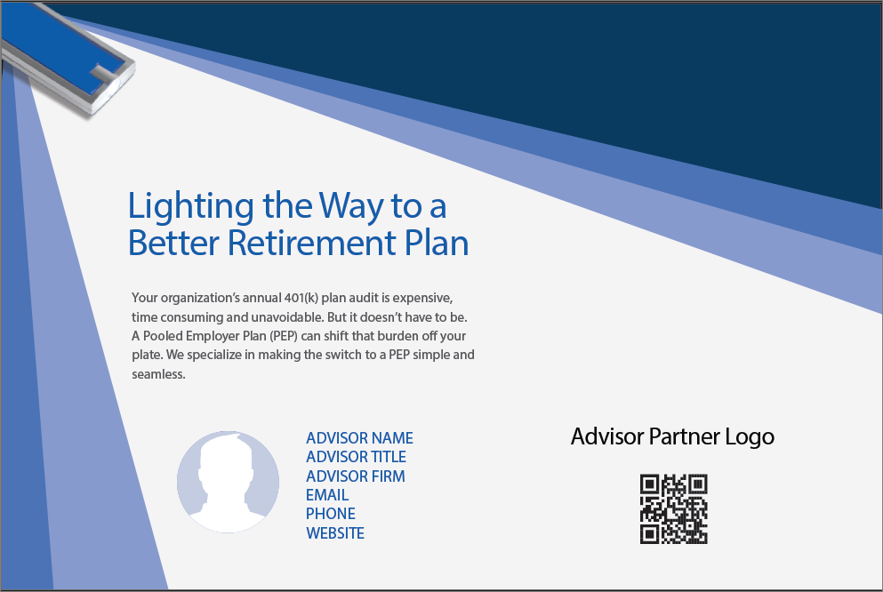
Direct Mail
Our team can help you create a direct mail post card. It serves as a tangible and unique way to get attention and generate awareness. This approach only works when supported by timely follow-up outreach. The mailer serves as a conversation starter. For example: “You may have seen the mailer with the flashlight I sent you recently...”
We can add a QR code which will link to a custom landing page with additional information on PEPs. This code allows us to track basic engagement by measuring how many people visited the landing page from the mailing.
Postcard can be customized with your colors, contact information, headshot, logo and QR tracking code.

Slide 8


Direct Mail Logistics
Postcard
We can customize, print and ship the postcard directly to you. Once you approve a proof of the post card, we will ship it to you in approximately 10 days.
Flashlight & Bubble Envelope
You can purchase the flat flashlights here. (flashlights)
You will need the bubble envelopes to mail the postcard and flashlight. You can purchase those here. (bubble envelopes)
We recommend only mailing as many postcards at one time as you can personally follow up with within a seven-day window to ensure the highest impact and engagement.

Slide 9

Social Media Marketing
You can share these LinkedIn posts organically to engage your personal network or as targeted ads using a Matched Audience built from your prospect list. If you're using the Matched Audience option, follow the instructions on the following slide to upload your list and set up the campaign. Regardless, you will want to include your own contact information/meeting schedule links. You can also include a link to a landing page if applicable.
Example Social Post
Social Post Copy (images can be provided)
Post Copy 1
Your organization's annual 401(k) plan audit is expensive, time consuming and unavoidable. But it doesn’t have to be. A Pooled Employer Plan (PEP) can shift that burden off your plate. Our team specializes in making the switch to a PEP simple and seamless.
Call to Action
Include a contact method such as phone or email.
Post Copy 2
Traditional 401(k) plans come with annual plan audit stress and cost, as well as fiduciary risk. A Pooled Employer Plan (PEP) can reduce both. Our expert team makes the transition to a PEP painless — saving you time, eliminating audit costs and reducing your fiduciary responsibilities.
Call to Action
Include a contact method such as phone or email.

Slide 10
LinkedIn Matched Audience Targeting
A Matched Audience on LinkedIn is a custom targeting option that lets you reach specific people by uploading their contact information, such as email addresses. Note that a minimum of 300 matched contacts are required to run ads.
Uploading and Promoting to a Prospect List on LinkedIn
Prepare Your CSV List — Include emails ,names and company for best match rates.
Upload to Campaign Manager — Go to Plan > Audiences > Create Audience > Upload Contact List.
Create a Campaign — Choose an objective (e.g., Engagement or Website Visits).
Target Your Uploaded List — In audience setup, select your saved Matched Audience.
Build the Ad — Use the provided copy and image or post your own copy and image.
Set Budget & Launch — We recommended $20–$30/day for 7–10 days.

Slide 11
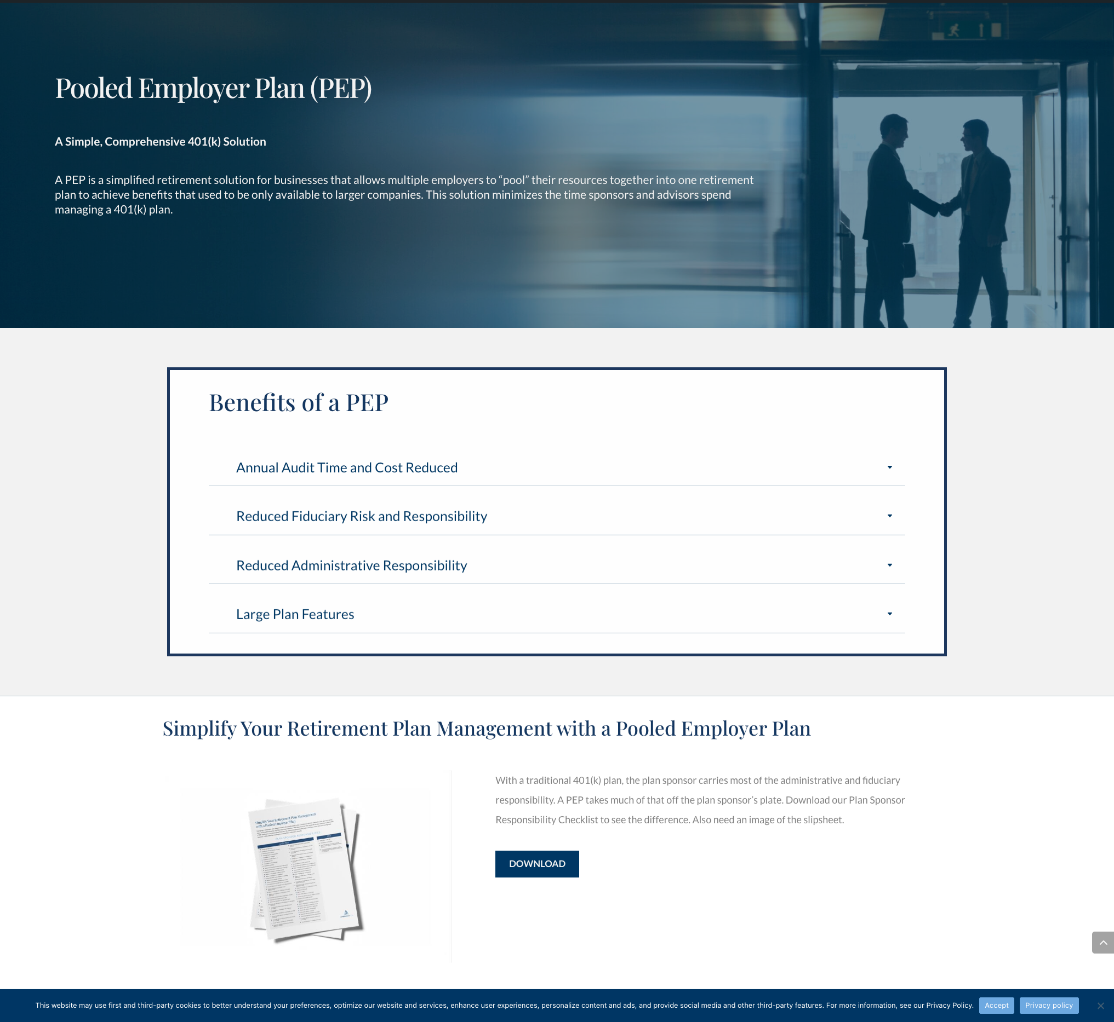
PEP Landing Page
This landing page is designed to provide additional information to prospects and position you as an authority on PEPs.
A link to this page can be included in your social media posts, in your email copy and on the direct mail postcard.
We can customize the page by adding your contact information and booking link.
Landing Page Example

Slide 12
Call Talking Points
Promoting PEPs requires a clear message. Here are talking points to help you start the conversation.
If you are following up on a prospect who received the email campaign or direct mail piece, you can start the conversation by mentioning those items.
You may have seen the mailer with the flashlight I sent you recently.
Is your annual 401(k) audit taking up too much of your money and time?
I know you likely spend a tremendous amount of money and time completing your annual 401(k) audit. Did you know there is a retirement plan that can eliminate your annual 401(k) independent audit expenses? A Pooled Employer Plan is a 401(k) plan that allows unrelated businesses to participate in one plan managed by a pooled plan provider (PPP). This ”pooled” retirement solution allows multiple employers to benefit from reduced costs, reduced administrative burdens and reduced fiduciary risk.
Reduce your annual audit costs.
With a PEP, your annual audit expenses are significantly reduced because the PEP is audited annually with no additional costs to the employer.
Reduce your administrative burden.
You will no longer have to deal with a plan auditor. In addition to handling the audit, the PPP is responsible for the overall management of the plan, including reviewing, signing and filing the annual Form 5500, approving all loans, distributions and QDROs, and distributing all required notices and disclosures to active and terminated participants .

Slide 13

Thank you for partnering with us!
25-084 (10/26)

